Slide 1
Chapter 14 – Goodness of Fit Tests and Categorical Data Analysis

Slide 2
Outline
Goodness of Fit Tests When Category Probabilities are Completely Specified
Goodness of Fit for Composite Hypothesis
Two-Way Contingency Tables

Slide 3

Testing for Homogeneity
Example 14.13 : A company packages a product in cans of 3 different sizes using 3 production line.
Non-conformance reason : Blemish on can, crack in can, improper pull tab location,
Pull tab missing, other
$H_{0}$:${ p}_{1j}=p_{2j}=p_{3j}, j=1, 2,⋯,5$
$H_{a}$: $the production lines are not$homogeneous with respect to the categories
 |  | Reason for Nonconformity |  |  |  |  | Sample Size
 |  | Blemish | Crack | Location | Missing | Other
Production Line | 1 | 34 | 65 | 17 | 21 | 13 | 150
 | 2 | 23 | 52 | 25 | 19 | 6 | 125
 | 3 | 32 | 28 | 16 | 14 | 10 | 100
 | Total | 89 | 145 | 58 | 54 | 29 | 375

Slide 4
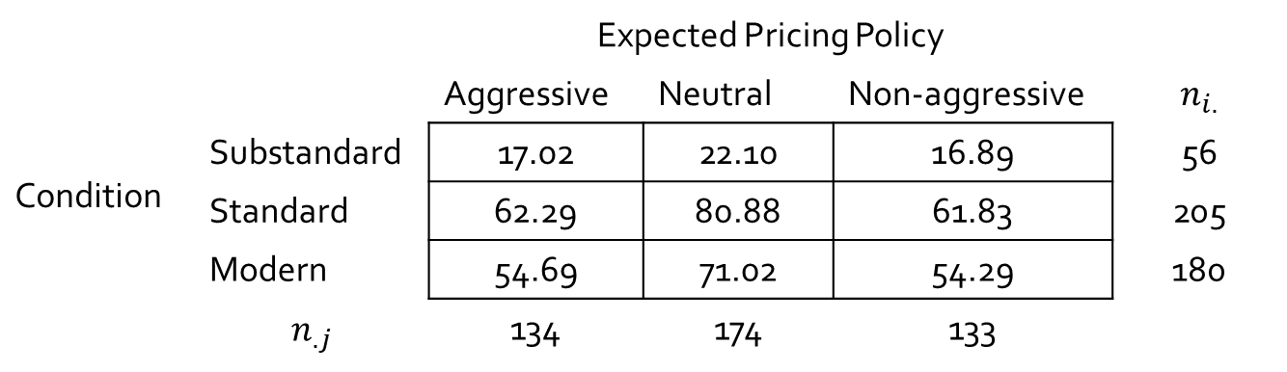
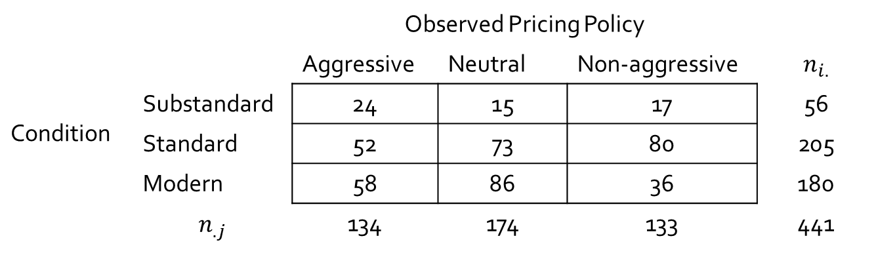
Testing for Independence
Example 14.14 : A study on the relationship between facility conditions of gasoline stations and aggressiveness in the pricing of gasoline was done.
 |  | Observed Pricing Policy
 |  | Aggressive | Neutral | Non-aggressive | $$n_{i.}$$
Condition | Substandard | 24 | 15 | 17 | 56
 | Standard | 52 | 73 | 80 | 205
 | Modern | 58 | 86 | 36 | 180
 | $$n_{.j}$$ | 134 | 174 | 133 | 441
 |  | Expected Pricing Policy
 |  | Aggressive | Neutral | Non-aggressive | $$n_{i.}$$
Condition | Substandard | 17.02 | 22.10 | 16.89 | 56
 | Standard | 62.29 | 80.88 | 61.83 | 205
 | Modern | 54.69 | 71.02 | 54.29 | 180
 | $$n_{.j}$$ | 134 | 174 | 133

Slide 5

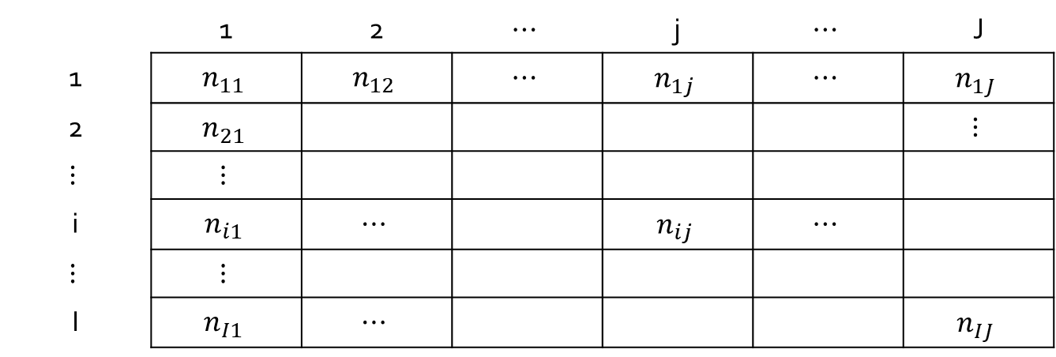

14.3 Two-Way Contingency Tables
We consider problems in which the data table have I rows and J columns.
Table 14.9 A Two-Way Contingency Tables
 | 1 | 2 | $$⋯$$ | j | $$⋯$$ | J
1 | $$n_{11}$$ | $$n_{12}$$ | $$⋯$$ | $$n_{1j}$$ | $$⋯$$ | $$n_{1J}$$
2 | $$n_{21}$$ |  |  |  |  | $$⋮$$
$$⋮$$ | $$⋮$$
i | $$n_{i1}$$ | $$⋯$$ |  | $$n_{ij}$$ | $$⋯$$
$$⋮$$ | $$⋮$$
I | $$n_{I1}$$ | $$⋯$$ |  |  |  | $$n_{IJ}$$
$$n_{i}$$
$$n_{.j}$$

Slide 6
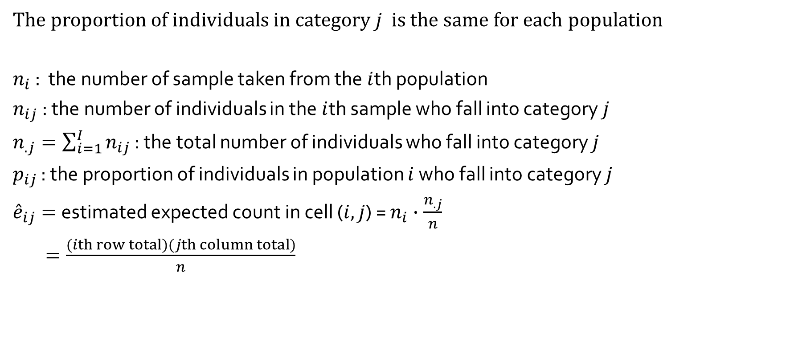
Testing for Homogeneity
The proportion of individuals in category $j$ is the same for each population
$n_{i}$ : the number of sample taken from the $i$th population
$n_{ij}$ : the number of individuals in the $i$th sample who fall into category $j$
$n_{.j}=\sum_{i=1}^{I}{n_{ij}}$ : the total number of individuals who fall into category $j$
$p_{ij}$ : the proportion of individuals in population $i$ who fall into category $j$
${\hat{e}}_{ij}=$estimated expected count in cell ($i, j$) = $n_{i}∙\frac{n_{.j}}{n}$
$=\frac{(ith row total)(jth column total)}{n}$

Slide 7
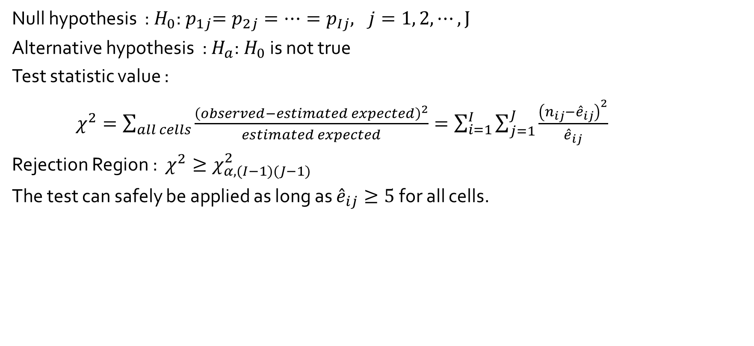
Testing for Homogeneity
Null hypothesis : $H_{0}$:${ p}_{1j}=p_{2j}=⋯=p_{Ij}, j=1, 2,⋯, J$
Alternative hypothesis : $H_{a}$:$H_{0}$ is not true
Test statistic value :
$χ^{2}=\sum_{all cells}{\frac{{\left(observed−estimated expected\right)}^{2}}{estimated expected}}=\sum_{i=1}^{I}{\sum_{j=1}^{J}{\frac{{\left(n_{ij}−{\hat{e}}_{ij}\right)}^{2}}{{\hat{e}}_{ij}}}}$
Rejection Region : $χ^{2}≥χ_{α,(I−1)(J−1)}^{2}$
The test can safely be applied as long as ${\hat{e}}_{ij}≥5$for all cells.

Slide 8
Testing for Homogeneity
Example 14.13 : A company packages a product in cans of 3 different sizes using 3 production line.
Non-conformance reason : Blemish on can, crack in can, improper pull tab location,
Pull tab missing, other
$H_{0}$:${ p}_{1j}=p_{2j}=p_{3j}, j=1, 2,⋯,5$
$H_{a}$: $the production lines are not$homogeneous with respect to the categories
 |  | Reason for Nonconformity |  |  |  |  | Sample Size
 |  | Blemish | Crack | Location | Missing | Other
Production Line | 1 | 34 | 65 | 17 | 21 | 13 | 150
 | 2 | 23 | 52 | 25 | 19 | 6 | 125
 | 3 | 32 | 28 | 16 | 14 | 10 | 100
 | Total | 89 | 145 | 58 | 54 | 29 | 375

Slide 9

Testing for Homogeneity
$${\hat{e}}_{11}=\frac{(first row total)(first column total)}{total of sample sizes}=\frac{(150)(89)}{375}=35.60$$
$${\hat{e}}_{21}=\frac{(second row total)(first column total)}{total of sample sizes}=\frac{(125)(89)}{375}=29.67$$
 |  | Reason for Nonconformity |  |  |  |  | Sample Size
 |  | Blemish | Crack | Location | Mission | Other
Production Line | 1 | 34(35.60) | 65(58.00) | 17(23.20) | 21(21.60) | 13(11.60) | 150
 | 2 | 23(29.67) | 52(48.33) | 25(19.33) | 19(18.00) | 6(9.67) | 125
 | 3 | 32(23.73) | 28(38.67) | 16(15.47) | 14(14.40) | 10(7.73) | 100
 | Total | 89 | 145 | 58 | 54 | 29 | 375

Slide 10
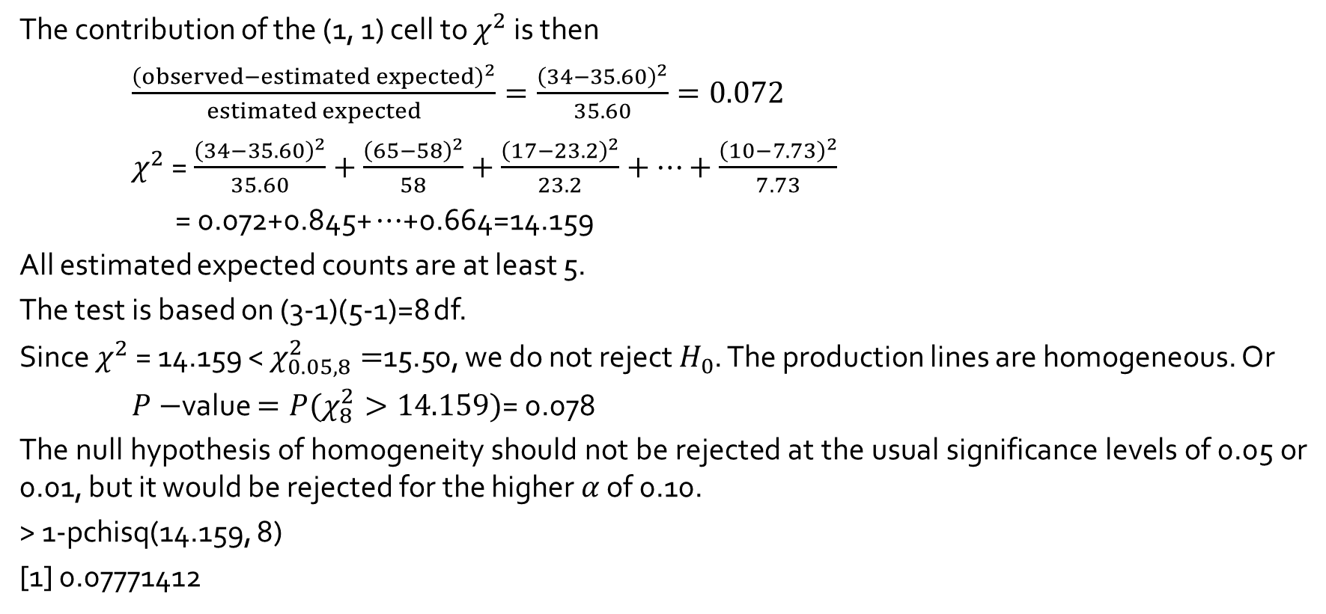
Testing for Homogeneity
The contribution of the (1, 1) cell to $χ^{2}$ is then
$\frac{{\left(observed−estimated expected\right)}^{2}}{estimated expected}=\frac{{\left(34−35.60\right)}^{2}}{35.60}=0.072$
$χ^{2}$ = $\frac{{\left(34−35.60\right)}^{2}}{35.60}+\frac{{\left(65−58\right)}^{2}}{58}+\frac{{\left(17−23.2\right)}^{2}}{23.2}+⋯+\frac{{\left(10−7.73\right)}^{2}}{7.73}$
= 0.072+0.845+ $⋯$+0.664=14.159
All estimated expected counts are at least 5.
The test is based on (3-1)(5-1)=8 df.
Since $χ^{2}$ = 14.159 < $χ_{0.05, 8}^{2}=$15.50, we do not reject $H_{0}$. The production lines are homogeneous. Or
$P−$value $=P(χ_{8}^{2}>14.159)$= 0.078
The null hypothesis of homogeneity should not be rejected at the usual significance levels of 0.05 or 0.01, but it would be rejected for the higher $α$ of 0.10.
> 1-pchisq(14.159, 8)
[1] 0.07771412

Slide 11
b <- matrix(c(24, 15, 17, 52, 73, 80, 58, 86, 36), nrow=3, byrow=T)
b
> chisq.test(b)
Pearson's Chi-squared test
data: b
X-squared = 22.476, df = 4, p-value = 0.0001611

